Slide 1
Guideline UserModel
Famke Kraaijeveld, PTI/RC

Slide 2
Why Python
  Open source
  Fast to learn, many examples on the internet
  Common script language for commercial software e.g. TechLog
  Can be used as entry point for other programming languages (wrapper capabilities)
  Available via GI-D (Enthought Python Distribution)

Slide 3
How to create a UserModel in Python
The python script needs to contain 4 modules:
  get_input_parameters
  list of names for the parameters, to be shown in UI
  get_response_parameters
  list of names of the responses, to be shown in UI
  get_response
  calculation model of the responses, parameter list should coincide with the names
  get_zvalue
  Calculation model of the LSF or z value, such that negative values means failure

Slide 4
Set up CORA project
Set up UserModel Cora project

Slide 5
General workflow
Create your python model according to specifications
Open CORA project
Define failure model
Do the analysis

Slide 6
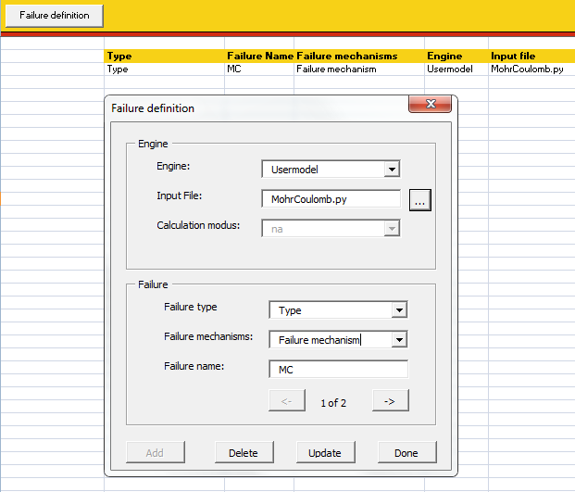
Define failure model
The model including objects of failure and failure mechanism are defined here.
Step 1: Choose your engine: UserModel
Step 2: Browse to Python script
Step 3: Give a <Failure name> (name will be used as indicator throughout analysis)
Step 4: Press <Add> and <Done>

Slide 7
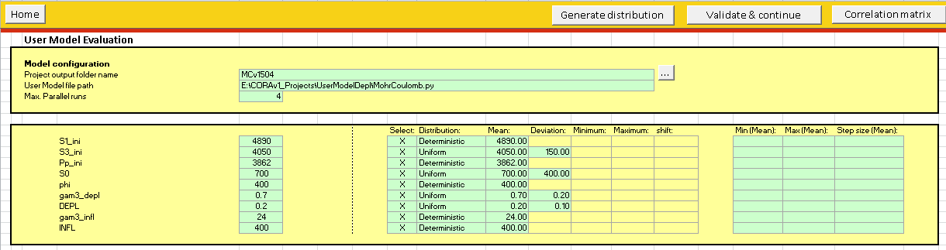
Define basecase and uncertainties
As the user model does not contain base values, these have to be defined with the uncertainties:
Step 1: Go to sheet < UserModel>
Step 2: Fill in calculation path and number of parallel threads
Step 3: Fill in the base case values (default deterministic)
Step 4: Define the uncertainty distributions and correlations (Button right top corner)
Step 6: Define min, max and step size for the control parameters (reliability analysis) when wanted
Step 7: When satisfied press <Validate and continue>
Python script
Parameters

Slide 8
Further analysis
The rest of the workflow is the same as for the other engines.
Quick screening:
  When multiple responses are listed in the model, they will all be calculated in the quick screening
  The relation between the parameters and the responses can be analysed by examining the different proxies.
  Reliability analysis
  The limit function of choice can be selected or all
  The limit provided is the resistance given to the function <get_zvalue>

Slide 9
User model best practice
  Validate input (set response to ‘nan’ or raise value error when invalid input)
  No print statements (slows calculation down)
  Use clear names
  LSF > 0 is no failure
  QuickBlocks comes with python “lite” (pythonw.exe) and can therefore be used as python engine

Slide 10
ExamplE use of user model

Slide 11
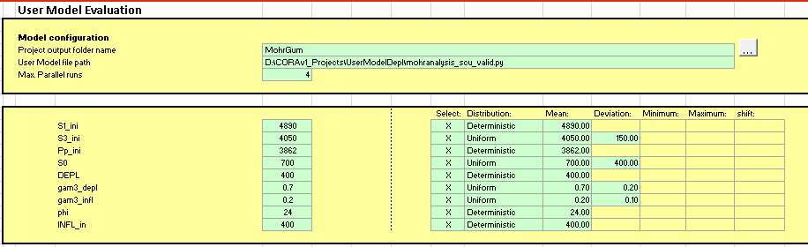
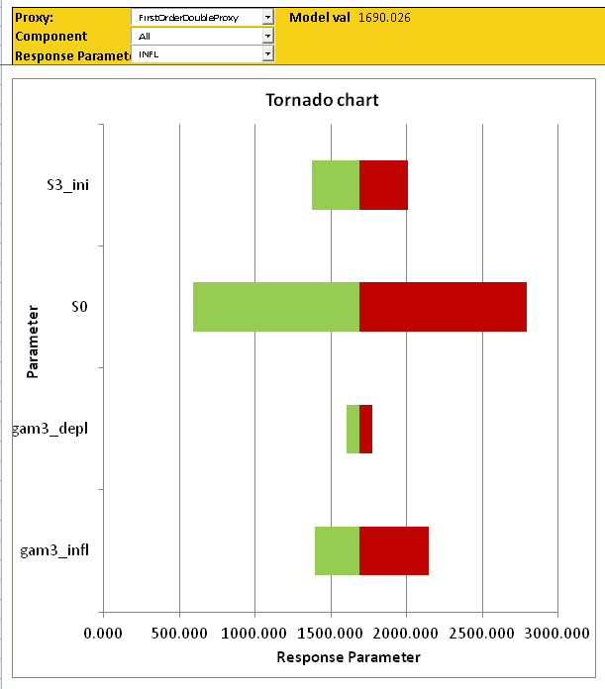
EXAMPLE: Allowable injection pressure (1)
Objective: Maximum allowable injection pressure?
Step 1: Analytical model + uncertainties
Step 2: Screening: Cohesion (S0) has large impact on safety margin, because of
M.C. failure model;
Large uncertainty range

Slide 12
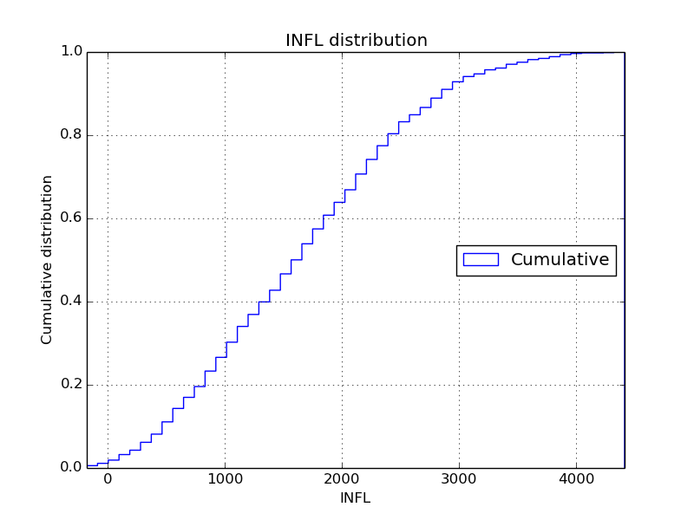
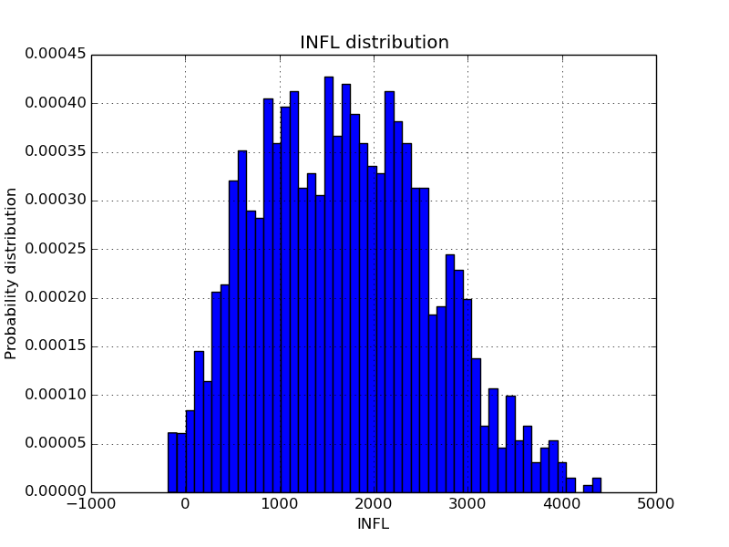
EXAMPLE: Allowable injection pressure (2)
@ DEPL = 400
When 10% safe,
max INFL = 450 psi

Slide 13
Example Python files

Slide 14
DUMMY MODEL
import sys
import numpy as np
def get_input_parameters():
return ["A", "B", "C", "D", "E"]
def get_response_parameters():
return ["Result 1", "Result 2"]
def get_response(par1,par2,par3,par4,par5):
errval = float('NaN')
if par1 < 0:
resp = [errval, errval]
else:
res1 = par5 - par4 - par3 - par2 - par1
res2 = par5 + par4 - par3 - par2
resp = [res1, res2]
return resp
def get_zvalue(responsename, response, resistance):
if responsename == "Result 1" :
z = response[0] - resistance
elif responsename == "Result 2" :
z = resistance - response[1]
else:
raise ValueError("response name unknown")
return z

Slide 15
A Tensile failure Model
  Analysis with different stress paths for depletion and injection
  Check by running “checkyourmodel_TF.py”
  Response part (geomechanical response, check if S1>S3):
## Stress ratio
Sig1_eff = S1_ini - (Pp_ini-DEPL+INFL)
Sig3_eff = (S3_ini-(DEPL*gam3_depl)+INFL*gam3_infl) - (Pp_ini-DEPL+INFL)
SR = Sig3_eff / Sig1_eff
## Tensile Failure
TensFail = np.min([Sig3_eff, Sig1_eff])
### RESPONSE CALCULATION
resp = [SR, TensFail]
  Failure part (be careful of the sign!!):
if respname == "SR" :
LSF = -(resp[0] - resistance)
elif respname == "TensFail" :
LSF = -(resistance - resp[1])
else: raise ValueError("response name unknown")

Slide 16
A Shear Failure Model
  Analysis with different stress paths for depletion and injection
  Check by running “checkyourmodel_MC.py”
  Response part (geomechanical response, check if S1>S3):
    ## SCU
    tau = ( Sig1_eff - Sig3_eff )/2.
    sig_a = ( Sig1_eff + Sig3_eff )/2.
    taumax = S0 * np.cos( phirad ) + sig_a * np.sin( phirad )
    if taumax <= 0:
    SCU = 10.
    else:
    SCU = tau/taumax
    ### RESPONSE CALCULATION
    resp = [SR, SCU]
  Failure part (be careful of the sign!!):
    if respname == "SR" :
    LSF = resp[0] - resistance
    elif respname == "SCU" :
    LSF = resistance - resp[1]
    else: raise ValueError("response name unknown")

